Slide 1
Neurons Support a Remarkable Range of Computation
Randall C. O’Reilly
University of Colorado Boulder

Slide 2
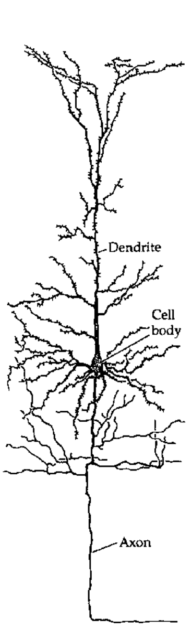
The Basic Unit of Intelligence!?

Slide 3
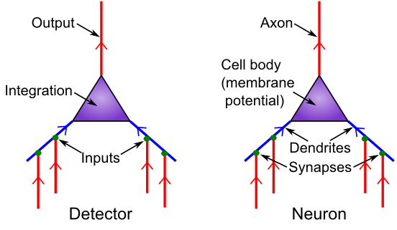
Detector Model
How far can you go with detection?

Slide 4
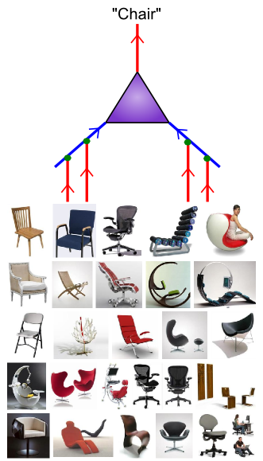
Detectors naturally perform categorization
Categorizing things properly is maybe 80% of the solution to any problem (symbolization):
Object recognition
Spoken word recognition
Idiom recognition
Relationship recognition
Person recognition
Action recognition
…
Problem solving:
Two men are dead in a cabin in the woods. What happened?

Slide 5
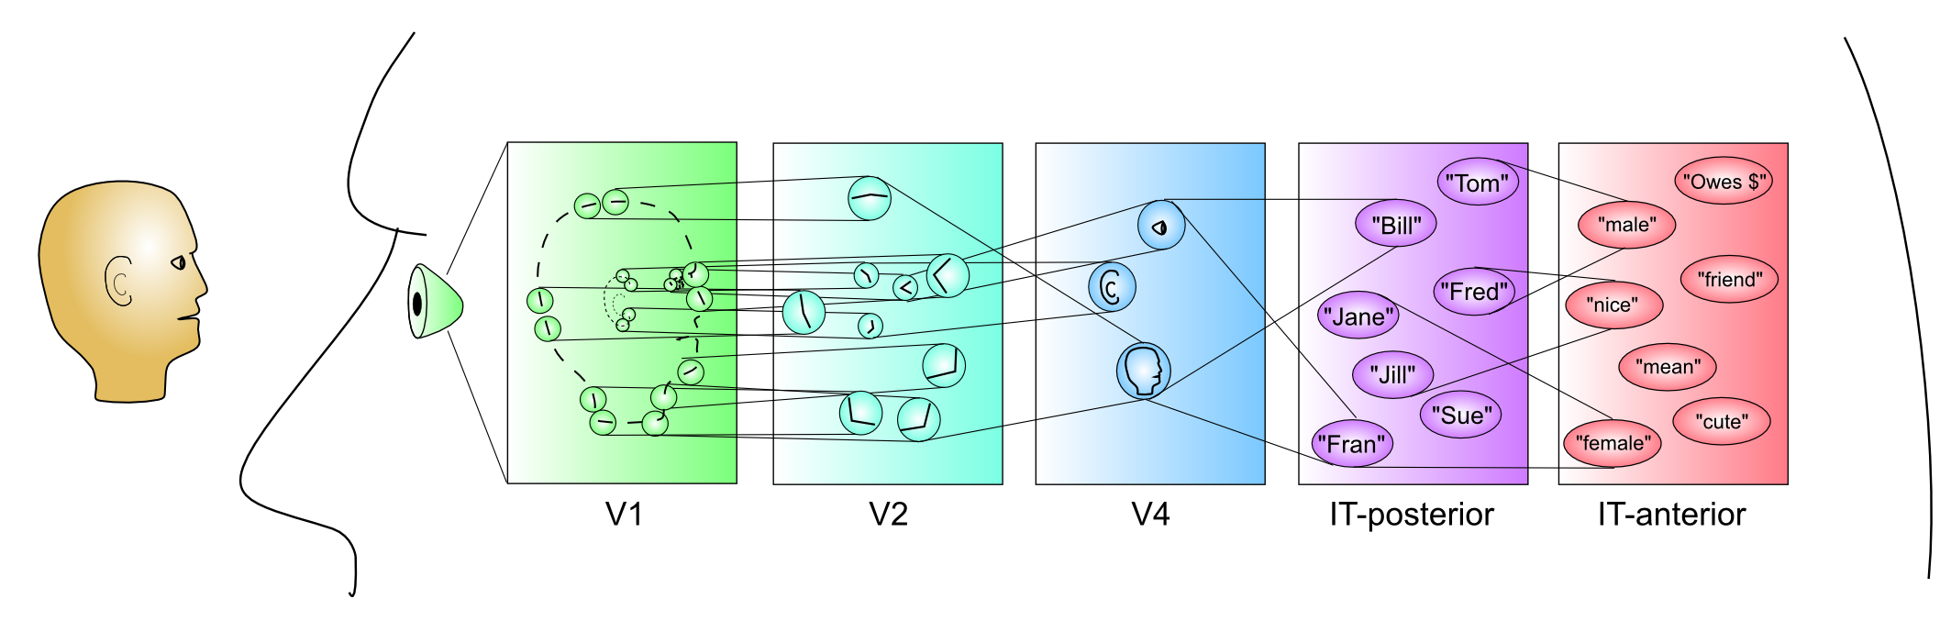
Hierarchy of Categories

Slide 6
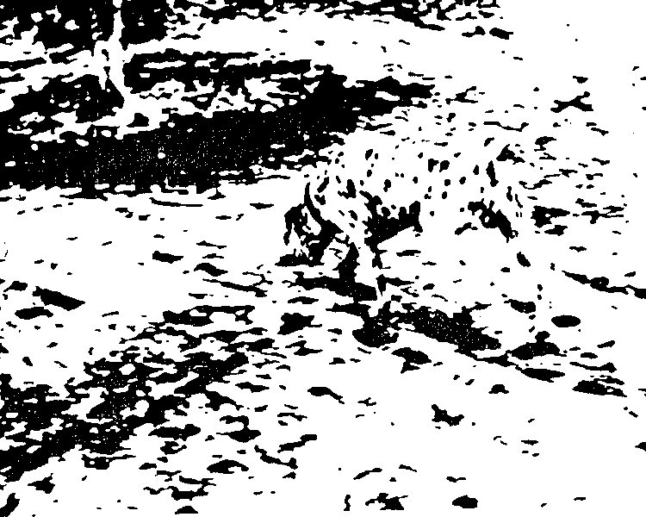
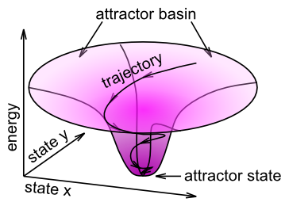
Dynamics are Important
Figure-ground, top-down & bottom-up constraint satisfaction..

Slide 7
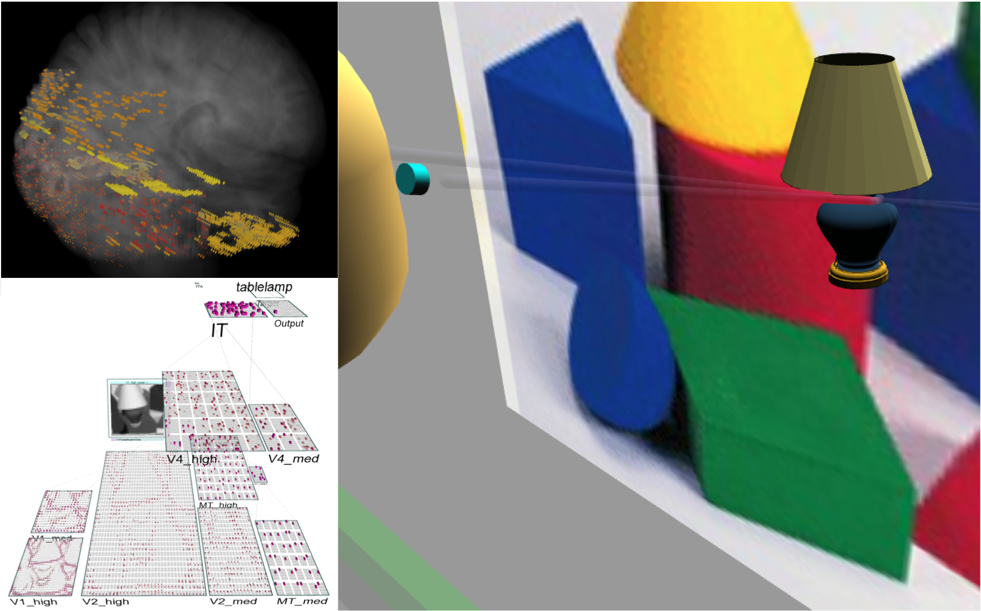
“Emer” Virtual Robot

Slide 8
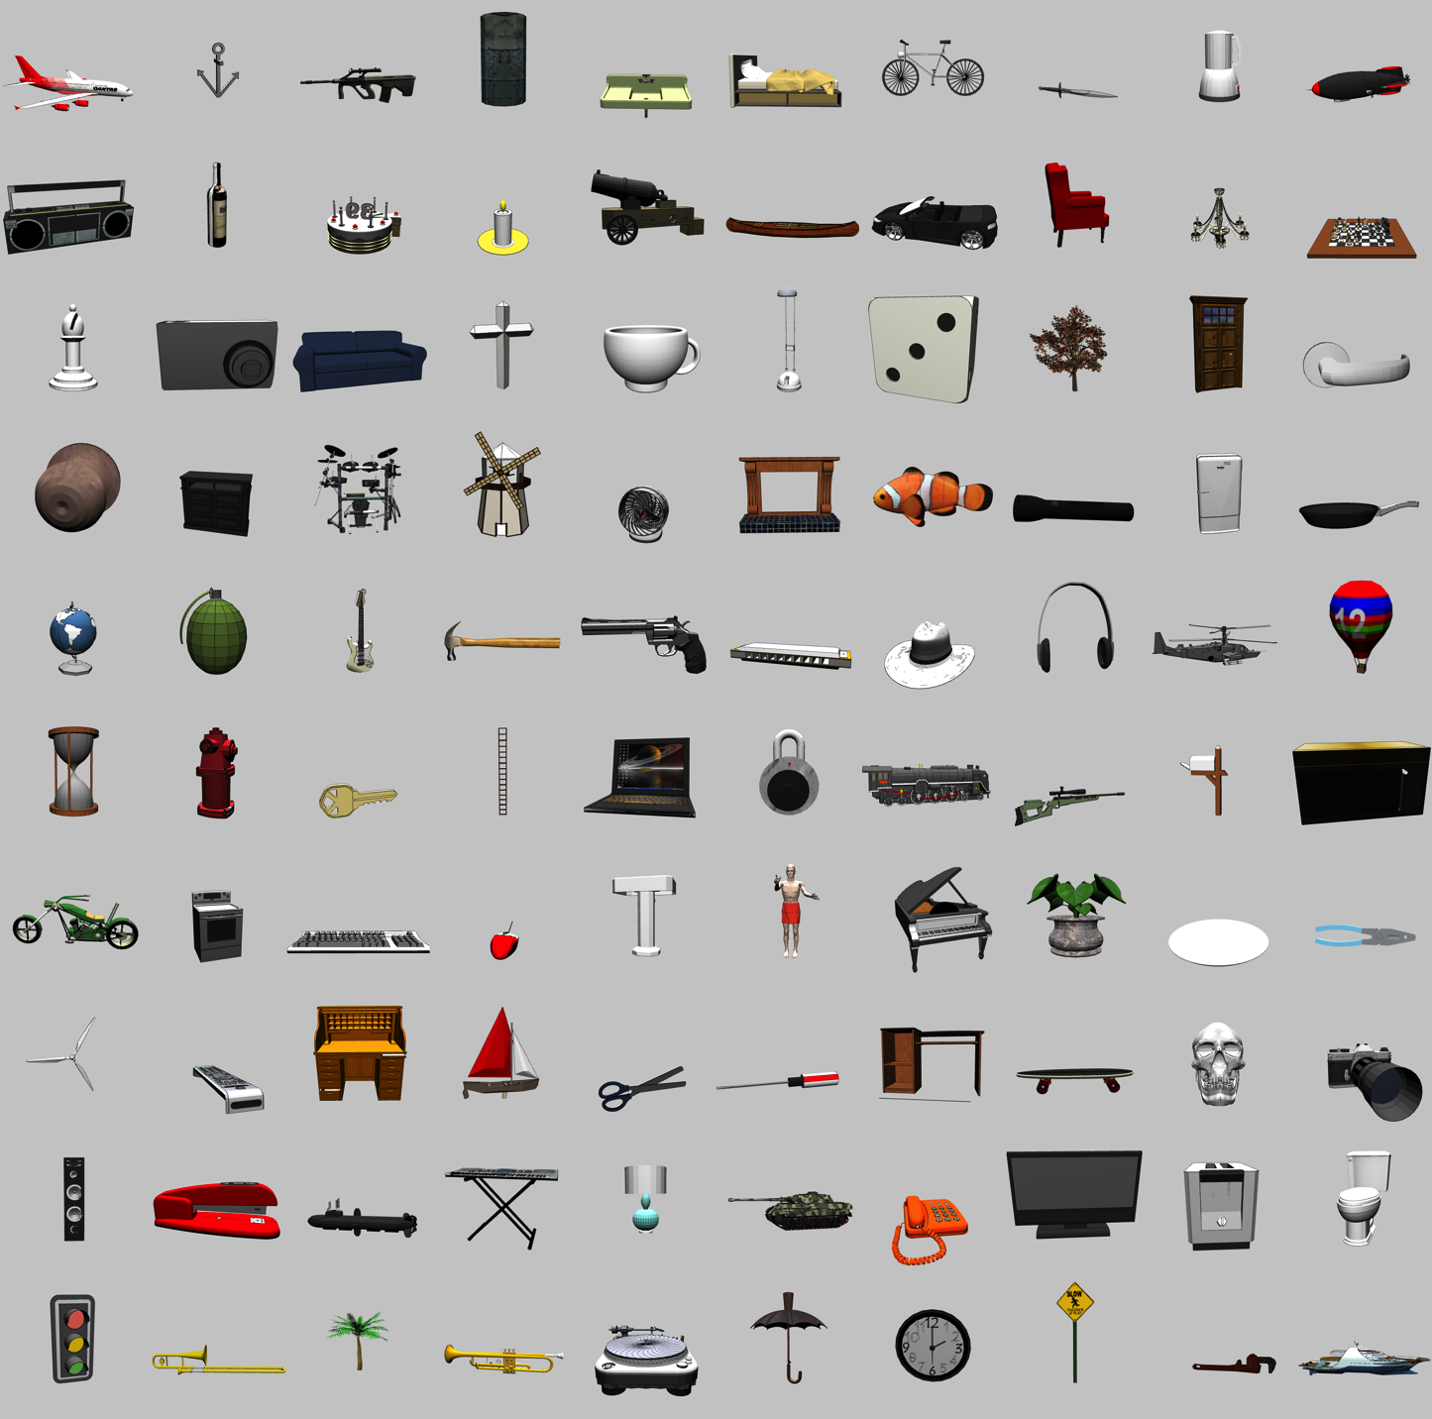
3D Object Recognition Test
From Google SketchUp Warehouse
100 categories
8+ objects per categ
2 objects left out for testing
+/- 20° horiz depth rotation + 180° flip
0-30° vertical depth rotation
14° 2D planar rotations
25% scaling
30% planar translations

Slide 9
Generalization to Novel Category Exemplars – Better than 90%
(Consistent with recent independent evaluation)
*100% on novel views of trained categories (with multiple fixations)!

Slide 10

Benefit of Bidirectionality: Robust to Partial Occlusion
50% Occlusion

Slide 11
Human Data

Slide 12
Comparison to AI Techniques
k-Means, Chinese Restaurant, Indian Buffet..
A virtual smorgasbord!
Challenges: hierarchy, bidirectional constraint satisfaction
HMAX et al: insert your favorite feature set, apply MAX pooling, run a SVM..
Deep Networks: backprop+.. Generative framework compatible with MAX translation invariance?
Bidir constraint satisfaction = messy, inhibition + excitation (edge of epilepsy)..

Slide 13
What is Remaining 20%?
High capacity content addressable memory
Biology: hippocampus
AI: anything here?
Online perceptual control of complex motor skill
Biology: parietal lobe + cerebellum
AI: forward models, PID feedback control..
Decision making and action selection
Hierarchical sequences of planned actions
Biology: Frontal cortex and basal ganglia
AI: RL, POMDP, dynamic programming..

Slide 14
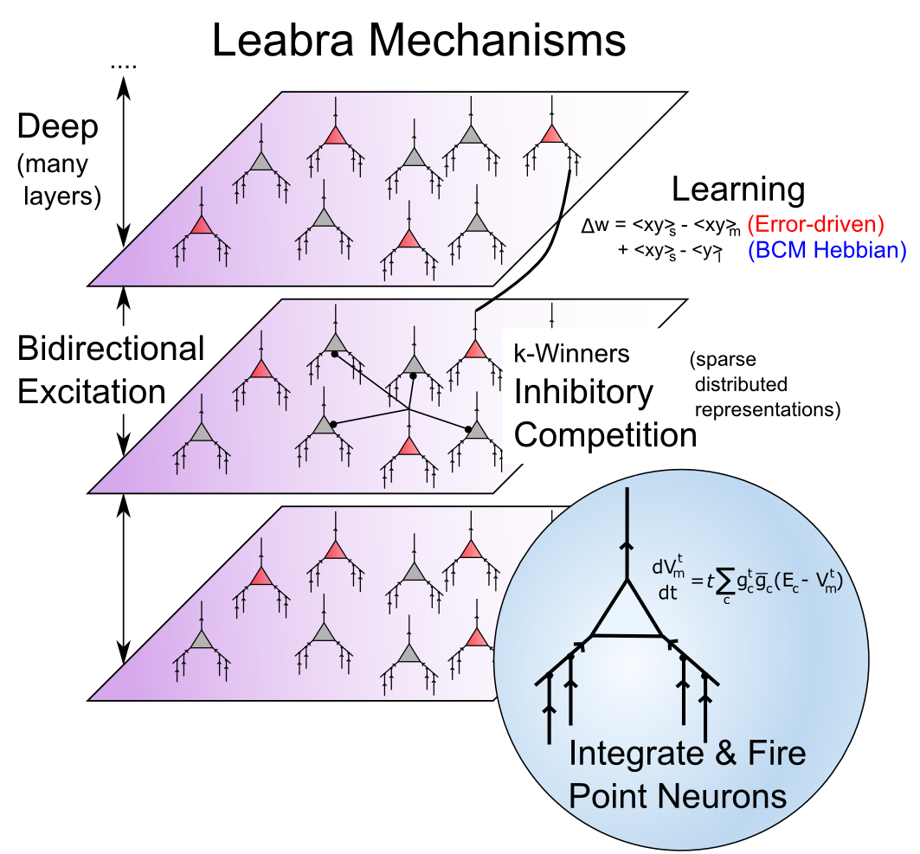
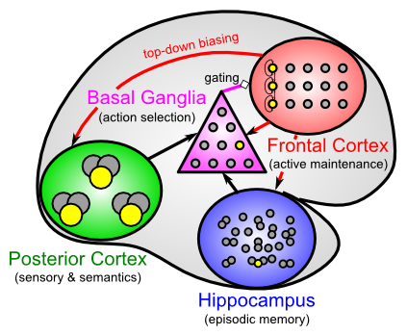
Biologically-based Cognitive Architecture
Same framework accounts for wide range of cognitive neuroscience phenomena: perception, attention, motor control and action selection, learning & memory, language, executive function – all built out of the same neurons.

Slide 15
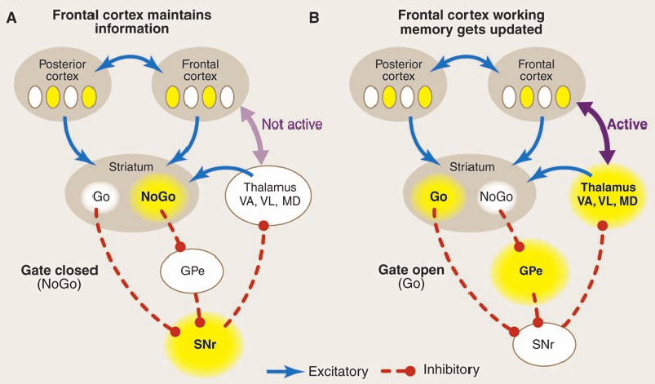
Dynamic, Adaptive Gating (BG) (O’Reilly & Frank, 2006; O’Reilly 2006)
A) BG = NoGo (indirect pathway), PFC continues to maintain sustained firing.
B) BG = Go (direct pathway) triggers updating of PFC to encode new information

Slide 16
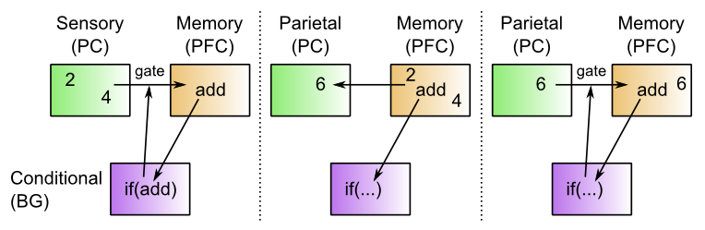
PFC / BG Production System
Essentially a Turing machine: conditionals, iteration, memory updates, etc..
BG gating encodes the program steps, drives memory updates
PFC maintains the memory, drives top-down processing in posterior cortex

Slide 17
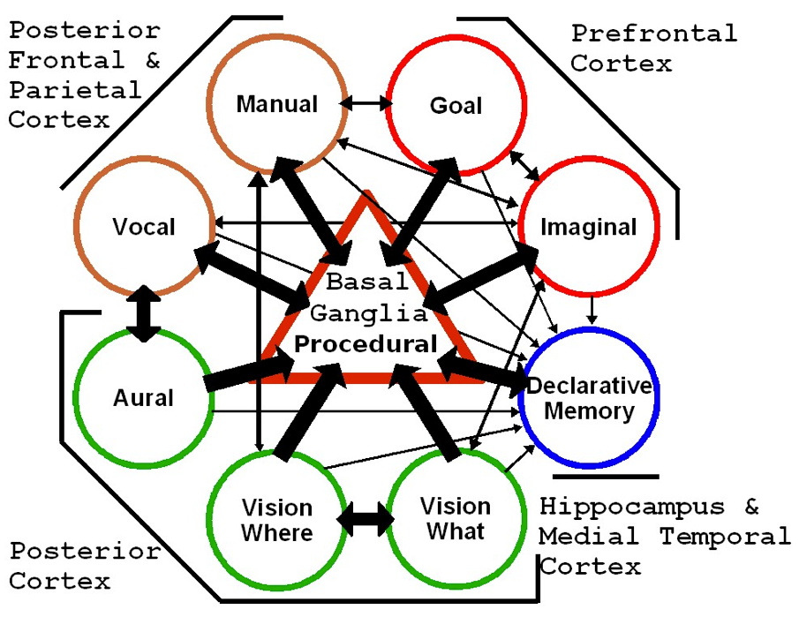
SAL: Synthesis of ACT-R & Leabra (Jilk, Lebiere, O’Reilly & Anderson, 2008)
(ACT-R now available in emergent)
Convergent architecture from very different trajectories and constraints

Slide 18
Convergent Pluralism
ACT-R model and Leabra model of same task
ACT-R serves as an implemented task analysis
Guides slower development and training of neural model
Latest approach: ACT-R is a Tutor (again) for Leabra neural models, which learn more slowly to perform same functionality – many opportunities to compare and contrast…

Slide 19
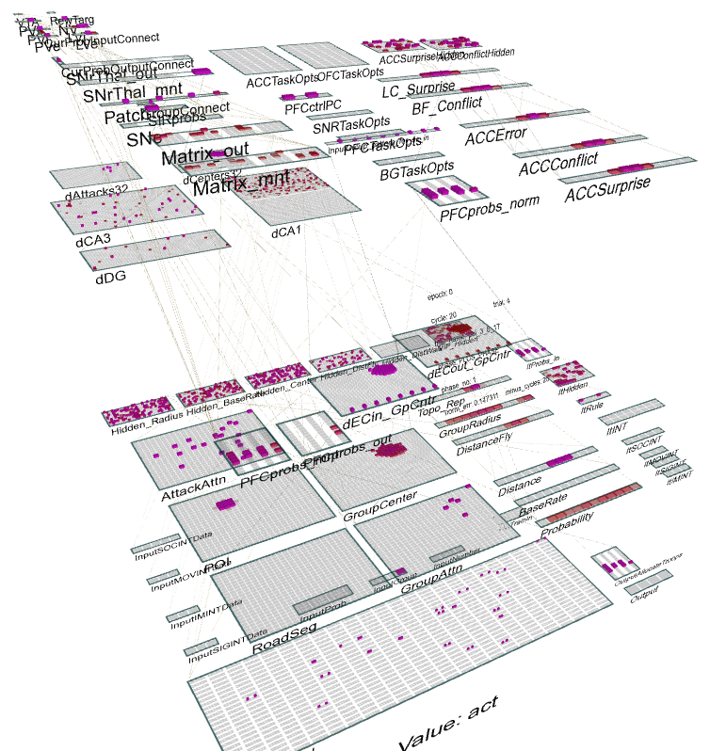
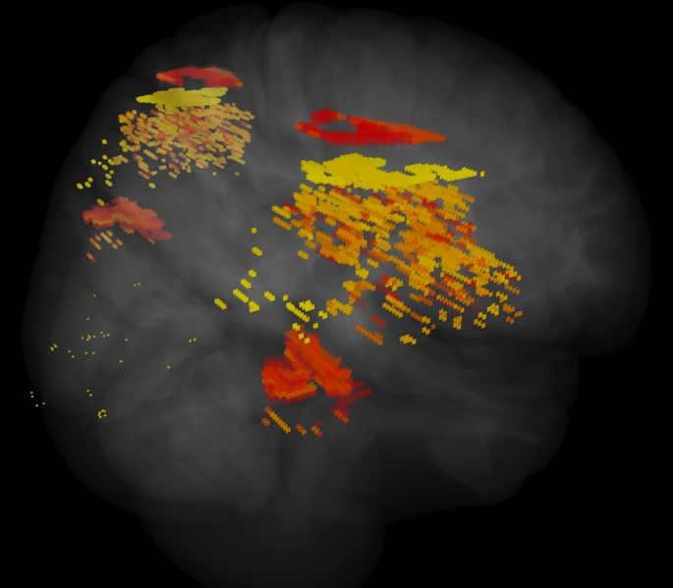
ICArUS-MINDS (IARPA) Integrated Cognitive Architecture for Understanding Sensemaking Mirroring Intelligence in a Neural Description of Sensemaking
Team: HRL (R. Bhattacharyya), CU Boulder (R. O’Reilly), CMU (C. Lebiere), UTH (H. Wang), PARC (P. Pirolli), UCI (J. Krichmar)
Goal: Build biologically-based cognitive architecture to model intelligence analyst.
Brain areas:
Posterior Cortex (IT, Parietal)
PFC/BG/DA
Hippocampus
BNS: LC, ACh

Slide 20
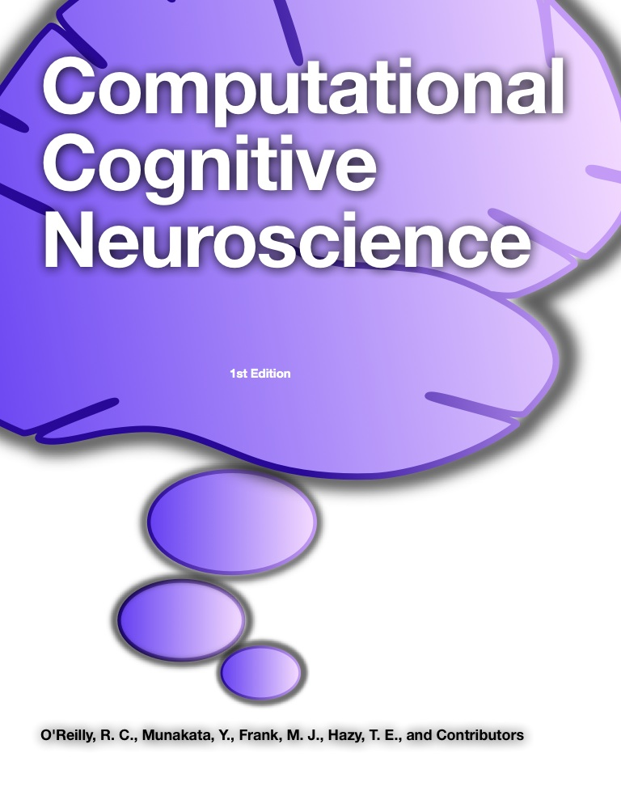
ccnbook.colorado.edu

Slide 21
Thanks To
CCN Lab
Tom Hazy
Seth Herd
Tren Huang
Dave Jilk (eCortex)
Nick Ketz
Trent Kriete
Kai Krueger
Brian Mingus
Jessica Mollick
Wolfgang Pauli
Sergio Verduzco-Flores
Dean Wyatte
Funding
ONR – Hawkins
ONR – McKenna & Bello
IARPA – Minnery
ARL RCTA
NIMH P50-MH079485

Slide 22
Discussion

Slide 23
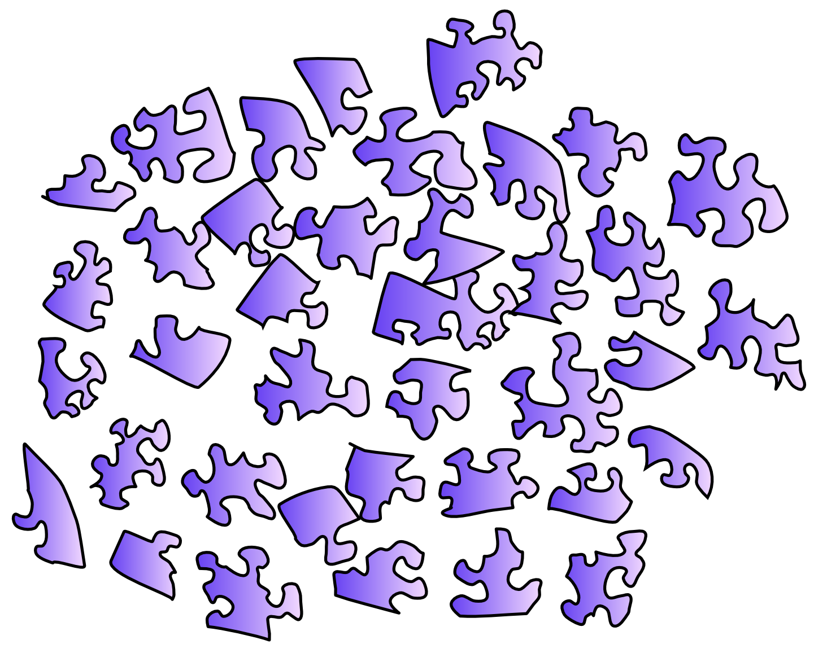
The Problem

Slide 24
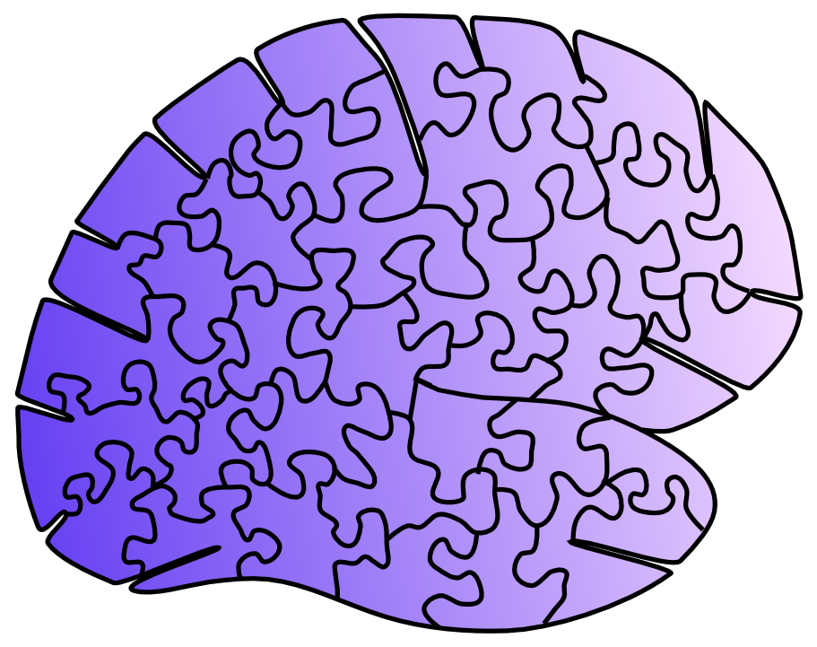
The Problem

Slide 25
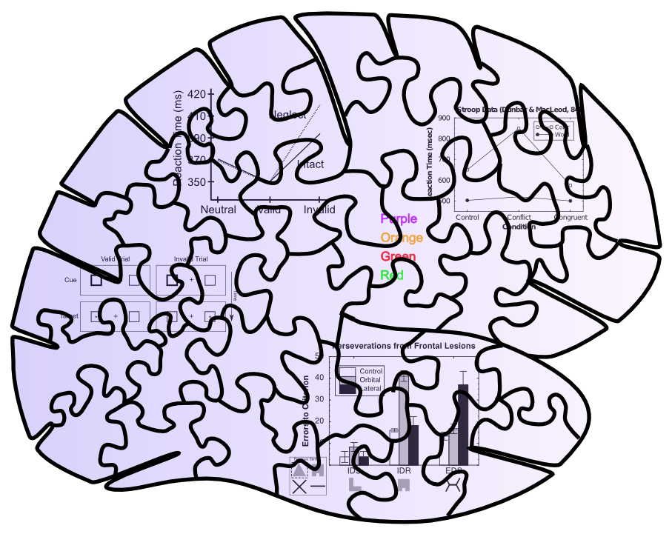
Behavioral Constraints

Slide 26
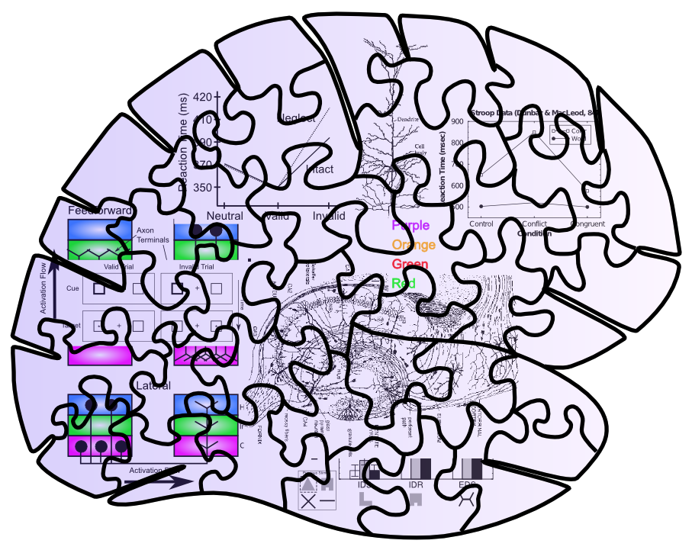
Neuro + Behavioral Constraints

Slide 27
Messy Puzzles are Easier to Solve!!

Slide 28
Newell’s argument: Satisfy more constraints in an Integrated Architecture
(Biology just as, if not more, constraining vs. other kinds of data)

Slide 29
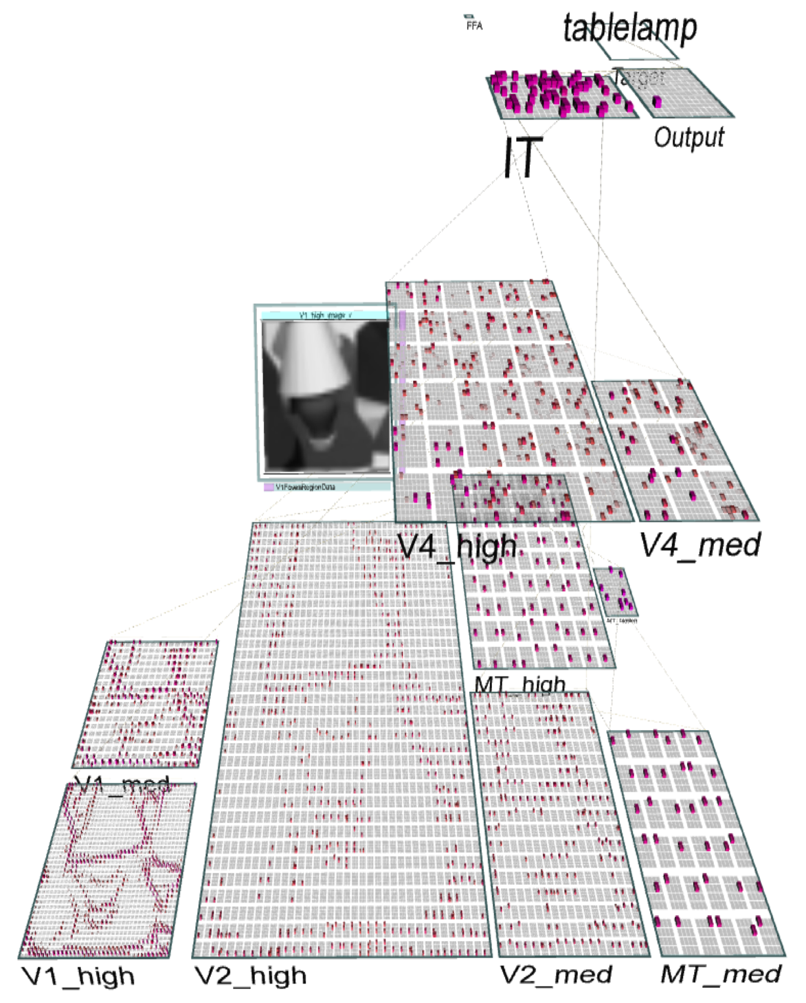
Emer’s Brain
Replicates known biology of visual system: V1, V2, V4, IT
Hierarchical extraction of spatial invariance and increasingly complex detectors.
Bidirectional connectivity produces considerable robustness (e.g., to occlusion) and constrains figure-ground processing in area V2

Slide 30
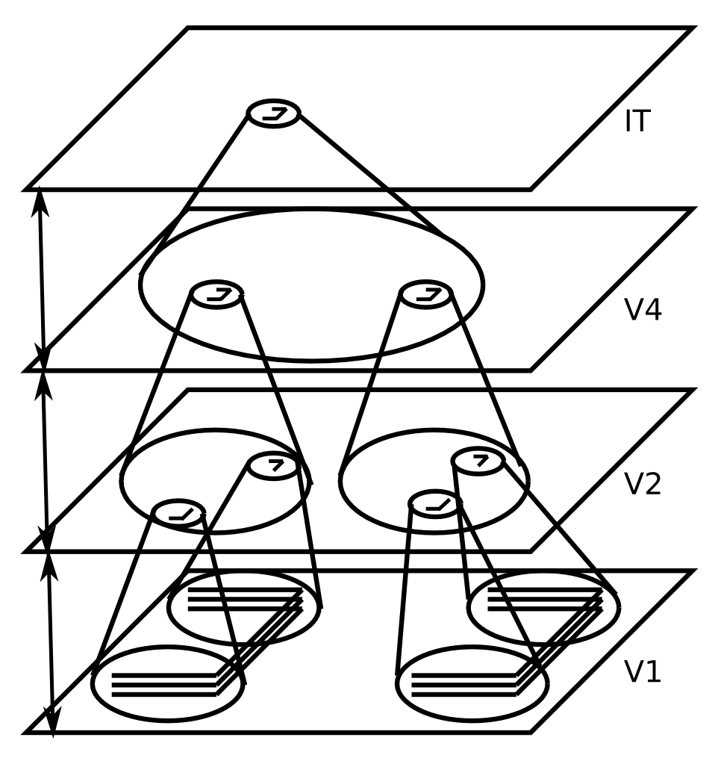
Invariant Object Recognition
Hierarchy of increasing:
Feature complexity
Spatial invariance
Strong match to RF’s in corresponding brain areas
(Fukushima, 1980; Poggio, Riesenhuber, et al…)

